Slide 1
Look-behinds for Rust regexes
Robin Hänni / Marcin Wojnarowski

Slide 2
Recap

Slide 3
Regex engines
Linear
Backtracking
Linear-time matching guarantees
Support only a subset of features
Examples:
regex crate (Rust)
RE2 (C++)
regexp package (Golang)
RE2/J (Java)
V8Linear (ECMAScript)
Potential exponential blowup
Support all features
Examples:
PCRE2 (C)
Almost all regex engines in the standard library of programing languages

Slide 4

Goal
Expansion of the subset of regexes accepted by linear engines in the Rust language ecosystem
Spoiler: it has been achieved!

Slide 5
Look-behind examples
/(?<=Title:\s+)\w+/
Title: HelloWorld
Title: Title: foo
No heading
title: bad case
Title:nospace
/(?<!dogs) are better/
Surely, cats are better
Maybe dogs are better?
Okay, Dogs are better.

Slide 6
Expectations vs Reality
Capture-less look-behinds
Capture-less look-aheads (requires additional memory)
General look-arounds including capture groups (depends on semantics)
Investigation of compatibility of algorithms in various regex engines
API for choice of the data structure for capture group for space-time-complexity trade-offs
Exploring algorithms for intersections in NFA/PikeVM
Lack of time, but strong foundations have been laid
Not investigated
Lack of time
No time to even cross our minds

Slide 7
Implementation

Slide 8
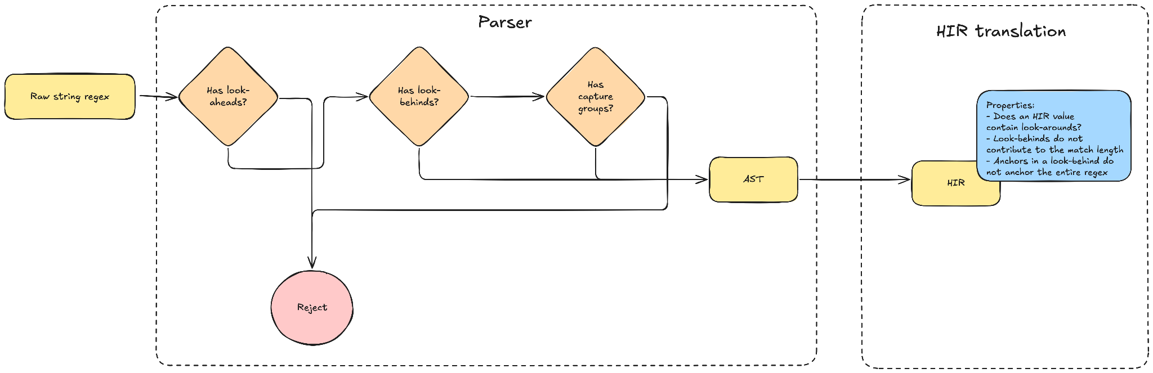
Phase 1: compiler frontend
Notes:
Parser
Here we reject unsupported features
Informative error when look-aheads are present or when there are capture groups in a look-behind
HIR
Just like Look, LookArounds do not contribute to the match length

Slide 9
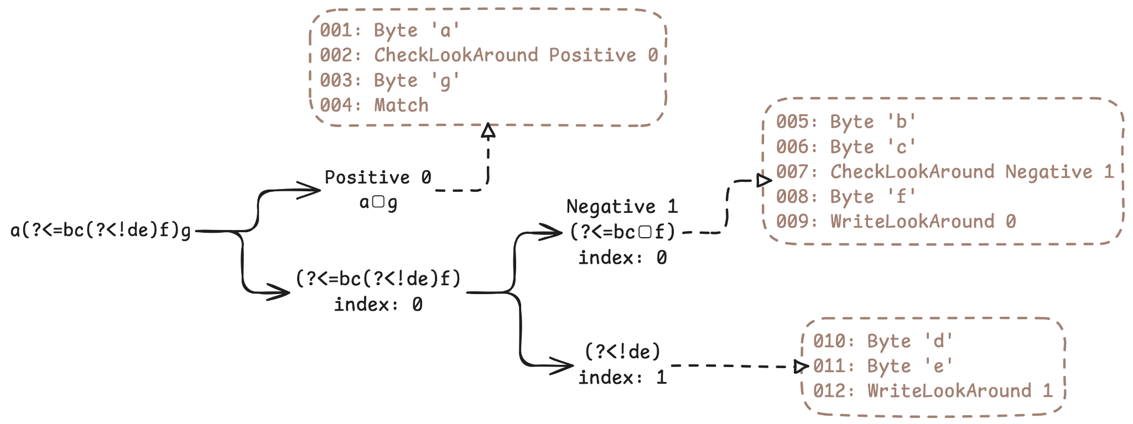
Phase 2: compiler backend

Slide 10
Phase 2: compiler backend

Slide 11
Phase 2: compiler backend

Slide 12
Phase 2: compiler backend

Slide 13
Phase 2: compiler backend

Slide 14
Phase 2: compiler backend

Slide 15

Phase 3: runtime
Start the look-behind automata at the start of the haystack

Slide 16
Phase 3: runtime
Start the look-behind automata at the start of the haystack
Make them catch up to the start of the searched range

Slide 17
Phase 3: runtime
Start the look-behind automata at the start of the haystack
Make them catch up to the start of the searched range
Start the main regex at the start of the searched range

Slide 18
Phase 3: runtime
Start the look-behind automata at the start of the haystack
Make them catch up to the start of the searched range
Start the main regex at the start of the searched range
Run everything in lock-step, character by character

Slide 19
Phase 3: runtime
Start the look-behind automata at the start of the haystack
Make them catch up to the start of the searched range
Start the main regex at the start of the searched range
Run everything in lock-step, character by character
Finish search when the main regex is out of states to explore

Slide 20
Phase 3: runtime
WriteLookAround idx
Side effect
Write into a table at index idx the current haystack position
This indicates that a look-behind found a match at this haystack position
CheckLookAround IsNeg idx
Impure
Consult the table at index idx
If IsNeg is true, and the table reports a haystack position equal to ours, it is a failed match
If IsNeg is false, and the table reports a haystack position different from ours, it is a failed match

Slide 21
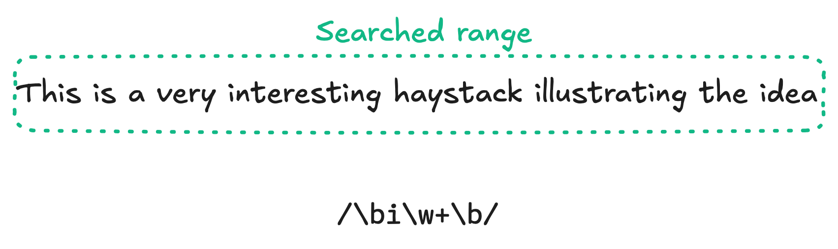
Phase 3: runtime, MatchAll hell

Slide 22
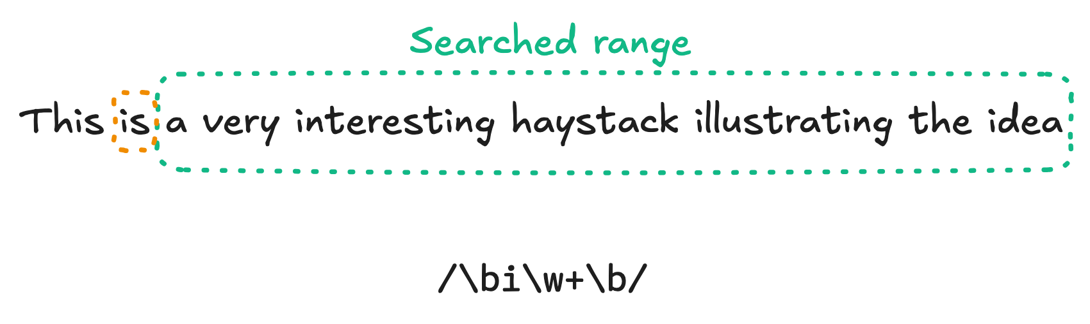
Phase 3: runtime, MatchAll hell

Slide 23
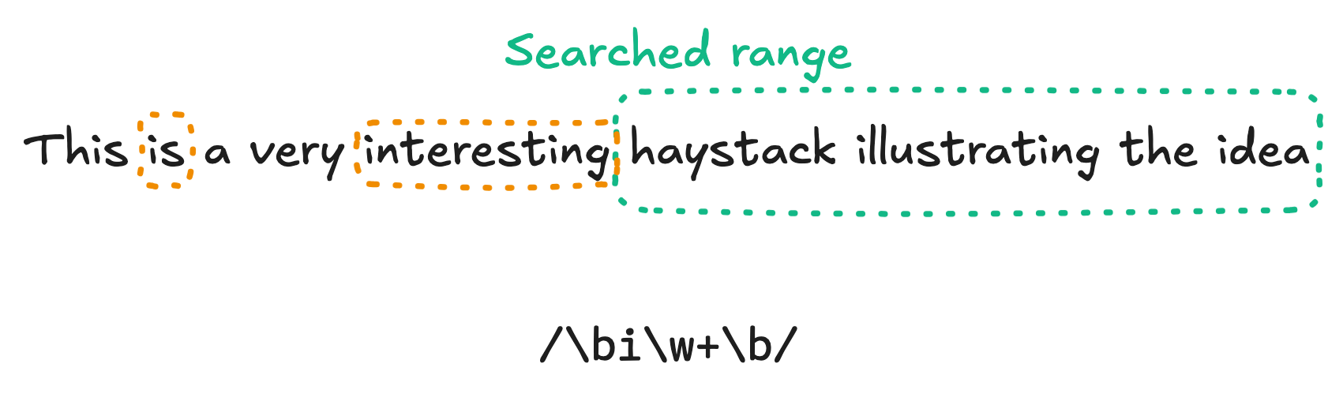
Phase 3: runtime, MatchAll hell

Slide 24
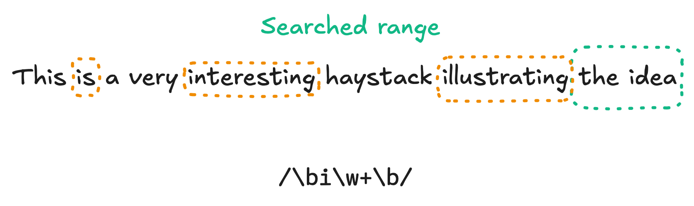
Phase 3: runtime, MatchAll hell

Slide 25

Phase 3: runtime, MatchAll hell

Slide 26
Optimization: bounded length look-behinds

Slide 27
Second runtime: bounded backtracker

Slide 28
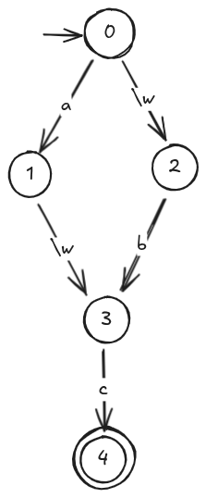
Memoization
 | a | b | d
0
1
2
3
4
Regex: (a\w|\wb)c
Haystack: abd

Slide 29
Memoization
 | a | b | d
0
1
2
3
4
Regex: (a\w|\wb)c
Haystack: abd

Slide 30
Memoization
 | a | b | d
0
1 |  | x
2
3
4
Regex: (a\w|\wb)c
Haystack: abd

Slide 31
Memoization
 | a | b | d
0
1 |  | x
2
3 |  |  | x
4
Regex: (a\w|\wb)c
Haystack: abd

Slide 32
Memoization
 | a | b | d
0 | x
1 |  | x
2
3 |  |  | x
4
Regex: (a\w|\wb)c
Haystack: abd

Slide 33
Memoization
 | a | b | d
0 | x
1 |  | x
2 |  | x
3 |  |  | x
4
Regex: (a\w|\wb)c
Haystack: abd

Slide 34
How to memoize look-behinds?
Keep two bits per table entry
First bit: same semantics as before
Second bit: set iff look-behind matched
Performance impact but complexity still ok

Slide 35
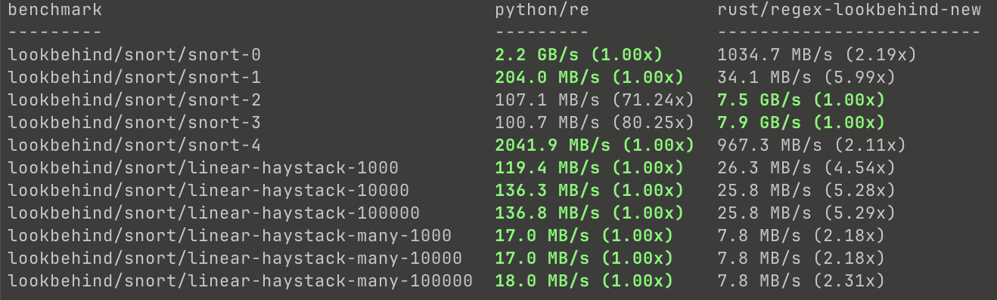
Performance results

Slide 36

Conclusions
Adds new features rather than improving existing ones
Benefits trickle-down(stream): ripgrep, fancy-regex, VSCode, all Rust users
"Contributor" badge in the rust-lang organization
PR opened, but no traction yet. Feel free to like, review, or approve

Slide 37
Le merci

Slide 38
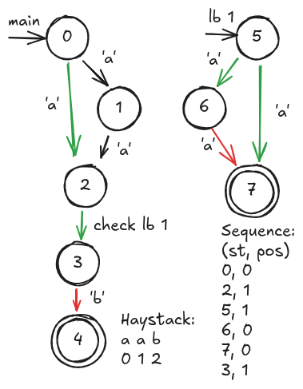
Wrong memoization example
Regex: ^(a|aa)(?<=aa?)b
Haystack:
aab

Slide 39
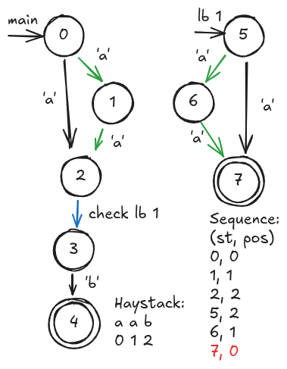
Wrong memoization example
Regex: ^(a|aa)(?<=aa?)b
Haystack:
aab

